Slide 1
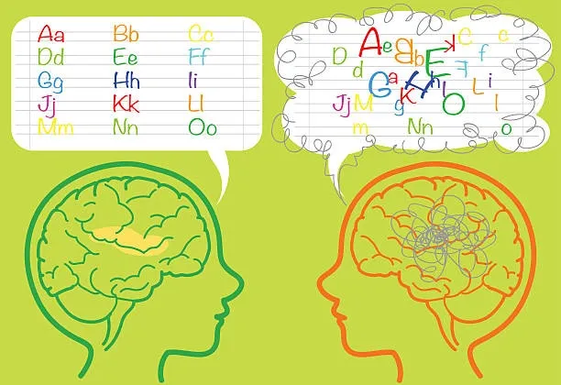
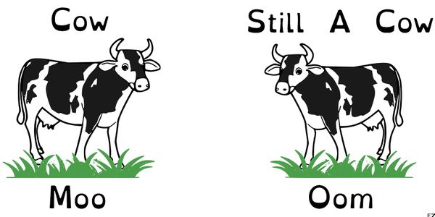
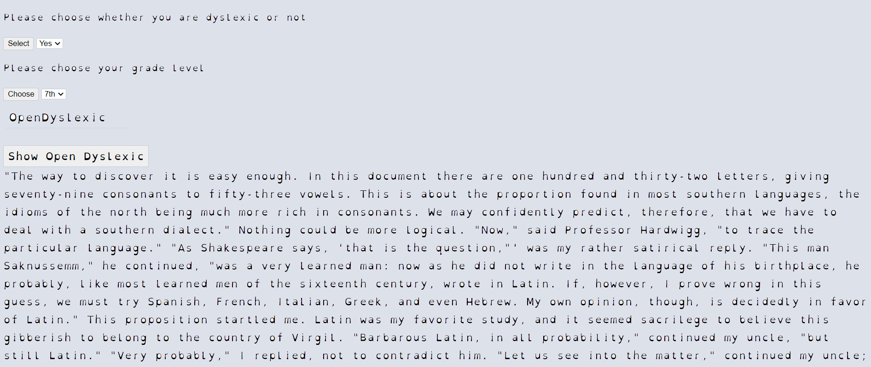
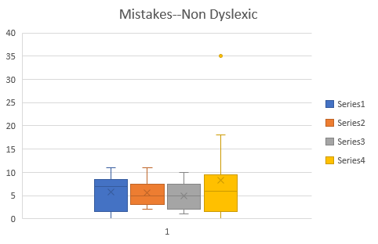
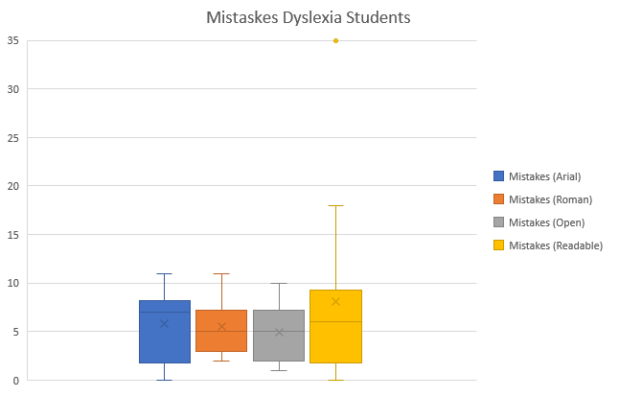
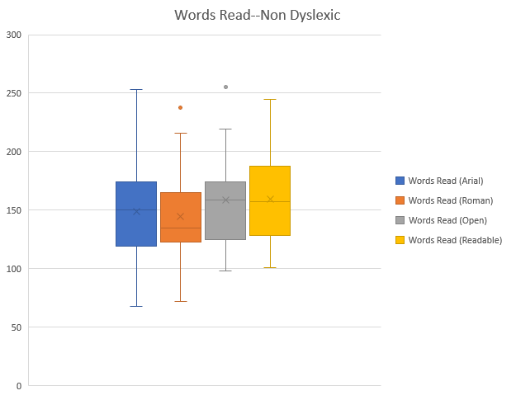
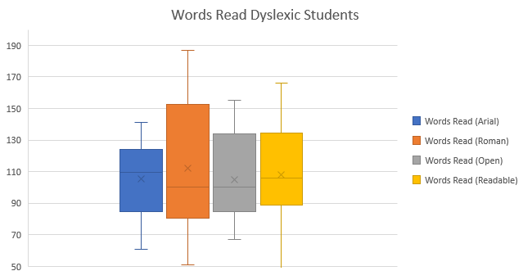
EZ Read With Dyslexic Fonts
www.dyslexiafonts.com
“Where Passion Meets Education”
_{Abstract}
Materials and Procedures
Conclusions
This topic was chosen because 15-20 % of people worldwide have dyslexia or another language based learning difference which interferes with the way they read, see the words, and learn despite being highly intelligent. It is a common misconception that a person with dyslexia has a lower IQ, should be placed in lower level or remedial class, and will never learn to read. This problem could become eased if early intervention occurs and a more decipherable or an easier to read font is used.
We have created a website with an online portal for our students to login and access the testing site. We have used HTML5, CSS, and JavaScript and it is hosted on GoDaddy as well as Heroku. We have implemented continuous integration and development through GitHub and Heroku. The entry point to our site is a landing page which describes our mission as well as provides access to our testing site. In order to normalize the results of our experiment, we have chosen four paragraphs correlated to their own Lexile level corresponding to each grade of the students. We anonymously collected the data by assigning each student a random identifier. The experiment was conducted presumably on 30 students by measuring their speed and accuracy. Our 60 second timed experiment involved two testers and one student at a time. We also marked the number of words misread and skipped per minute on an excel spreadsheet. Then we used Excel in or to conduct a detailed statistical analysis of the data followed by an ANOVA analysis to compare the various classes of the subjects based upon their grade as well as their learning style and differences.
The results of our data show that our hypothesis is partially confirmed. We were surprised to discover that dyslexic fonts such as Open Dyslexic and Lexia Readable appeared to be easier to read for students who are not dyslexic or have not been diagnosed with dyslexia, while the students with dyslexia, the results were inconclusive.
Future Directions
Purpose
We have to acknowledge that our study was tested on a small population (15 control group, 14 dyslexic), and therefore it might lack a statistical validity. In the future larger and more testing is needed to confirm our initial analysis.
We want to test how different types of fonts (Dyslexic versus Non-dyslexic Fonts) may affect the speed and accuracy of a Dyslexic versus a Non-dyslexic student when reading a passage for one minute. We created a website (dyslexiafonts.com) where the students can access all of the fonts and passages based on their level (Lexile).
References
Hypothesis
It was hypothesized that if Open Dyslexic font is used, then the accuracy and speed of both dyslexic and non-dyslexic students score will be higher because of the design is made with more spacing in between each letter and different thickness at the top of the letters.
Graphical Results
Student (Name) | Grade | Words Read (Arial) | Mistakes (Arial) | Words Read (Roman) | Mistakes (Roman) | Words Read (Open) | Mistakes (Open) | Words Read (Readable) | Mistakes (Readable) | Has Dyslexia
N.N. | 8 | 253 | 7 | 238 | 3 | 255 | 2 | 245 | 7 | NO
A. C. | 8 | 152 | 1 | 136 | 1 | 153 | 1 | 192 | 1 | NO
B. M. | 8 | 192 | 3 | 148 | 1 | 219 | 3 | 177 | 3 | NO
A. P. | 8 | 180 | 1 | 124 | 0 | 190 | 1 | 188 | 0 | NO
B. M. | 8 | 149 | 2 | 126 | 3 | 174 | 2 | 170 | 2 | NO
R. L. | 7 | 180 | 3 | 208 | 4 | 174 | 3 | 198 | 2 | NO
L.T. | 7 | 106 | 6 | 139 | 3 | 117 | 2 | 133 | 3 | NO
F.W. | 7 | 157 | 3 | 216 | 4 | 165 | 1 | 187 | 2 | NO
D.M. | 7 | 68 | 9 | 102 | 34 | 99 | 4 | 101 | 3 | NO
D.C. | 7 | 114 | 3 | 122 | 2 | 107 | 2 | 126 | 2 | NO
S.T. | 7 | 157 | 4 | 171 | 3 | 150 | 2 | 175 | 3 | NO
S.M. | 6 | 144 | 3 | 133 | 4 | 169 | 2 | 144 | 2 | NO
A.M. | 6 | 98 | 3 | 72 | 2 | 98 | 0 | 107 | 1 | NO
K.M. | 6 | 136 | 0 | 129 | 1 | 166 | 0 | 144 | 1 | NO
J.B | 6 | 151 | 2 | 139 | 3 | 152 | 1 | 127 | 3 | NO
M.D. | 6 | 141 | 3 | 110 | 5 | 151 | 1 | 141 | 2 | NO
 | average | 148.6 | 3.3 | 144.6 | 4.6 | 158.7 | 1.7 | 159.7 | 2.3
 | standard dev. | 42.6 | 2.3 | 43.7 | 8.0 | 42.0 | 1.1 | 38.3 | 1.5
Research Plan
We have created the EZ Read Dyslexia website for the students, which enabled them to securely login and take these four special fonts reading test based on their Lexile. We have been using a private school that specializes in dyslexia and other language-based learning differences along with a regular public school district for sampling the students. During their read a one minute timer will be set up and a Procter will mark a sheet of paper the number of words the student was not able to read accurately.
Student (Name) | Grade | Words Read (Arial) | Mistakes (Arial) | Words Read (Roman) | Mistakes (Roman) | Words Read (Open) | Mistakes (Open) | Words Read (Readable) | Mistakes (Readable) | Has Dyslexia
L.K. | 7 | 137 | 6 | 152 | 6 | 142 | 3 | 152 | 6 | YES
G.C. | 7 | 116 | 10 | 154 | 10 | 108 | 8 | 122 | 9 | YES
E.B. | 7 | 116 | 11 | 121 | 11 | 96 | 9 | 118 | 10 | YES
P.H. | 7 | 85 | 8 | 187 | 3 | 67 | 4 | 97 | 0 | YES
P.M. | 7 | 91 | 7 | 102 | 5 | 74 | 10 | 97 | 8 | YES
G.K. | 6 | 124 | 4 | 98 | 4 | 104 | 1 | 136 | 18 | YES
H.W. | 6 | 124 | 8 | 130 | 7 | 131 | 7 | 134 | 6 | YES
M.N. | 6 | 61 | 7 | 51 | 3 | 67 | 2 | 56 | 0 | YES
E.W. | 6 | 113 | 1 | 92 | 3 | 142 | 5 | 44 | 35 | YES
E.W. | 8 | 106 | 0 | 86 | 5 | 94 | 2 | 101 | 2 | YES
B.M. | 6 | 84 | 9 | 78 | 5 | 92 | 6 | 89 | 8 | YES
D.T. | 8 | 141 | 1 | 160 | 2 | 155 | 2 | 166 | 1 | YES
O.H. | 8 | 95 | 2 | 80 | 8 | 88 | 5 | 88 | 5 | YES
T.M. | 8 | 82 | 7 | 81 | 5 | 108 | 5 | 111 | 5 | YES
 | average | 105.4 | 5.8 | 112.3 | 5.5 | 104.9 | 4.9 | 107.9 | 8.1
 | standard dev. | 23.1 | 3.6 | 39.2 | 2.7 | 28.3 | 2.8 | 33.9 | 9.1

